Slide 1


Slide 2





Why this matters
Leadership quality shapes the conditions for great teaching
Variation in leadership behaviour creates variation in culture, consistency, and outcomes
We need a shared, practical language for effective leadership
Notes:
Decades of research show that leadership matters. Leithwood and colleagues’ work is often summarised as leadership being second only to classroom teaching in its influence on pupil learning. Large scale meta analytic studies, including the Balanced Leadership work, show an average effect size of around 0.25, which is educationally meaningful. These effects are mainly indirect but robust. Leadership shapes teaching quality, culture, and the conditions in which staff work. The cumulative message of this evidence is clear: when leadership improves, the conditions for learning improve, and student outcomes follow. Importantly, research comparing leadership approaches shows that leaders who focus on teaching quality and professional learning have a stronger impact than those who rely mainly on vision or charisma. This is why leadership development is a core improvement lever, not a peripheral one.

Slide 3

What the research says
Leadership has a measurable impact on pupil outcomes
“Leadership is second only to classroom teaching among school related factors influencing learning” - Leithwood et al. (2008, 2019)
Meta analysis shows an average effect size of around 0.25 between leadership and attainment - Waters, Marzano and McNulty (2003)
Leadership focused on teaching and learning has a stronger impact than leadership based mainly on vision or charisma - Robinson, Lloyd and Rowe (2008)
Notes:
Decades of research show that leadership matters. Leithwood and colleagues’ work is often summarised as leadership being second only to classroom teaching in its influence on pupil learning. Large scale meta analytic studies, including the Balanced Leadership work, show an average effect size of around 0.25, which is educationally meaningful. These effects are mainly indirect but robust. Leadership shapes teaching quality, culture, and the conditions in which staff work. Importantly, research comparing leadership approaches shows that leaders who focus on teaching quality and professional learning have a stronger impact than those who rely mainly on vision or charisma. This is why leadership development is a core improvement lever, not a peripheral one.

Slide 4


How leadership improves student outcomes
Teaching and learning focus
Leaders who prioritise curriculum coherence, instructional quality, and professional learning have the strongest impact (Robinson, Lloyd & Rowe, 2008)
Staff motivation, commitment, and working conditions
Leadership most powerfully affects outcomes indirectly through staff beliefs, efficacy, and organisational climate (Leithwood et al., 2008; 2019)
Notes:
Leaders influence outcomes by shaping what teachers believe, how they work, and the systems they operate within. Leadership effects are systemic, not symbolic.

Slide 5


How leadership improves student outcomes
Organisational systems and culture
Safe and orderly environments, collaborative structures, and protected instructional time increase impact (Leithwood, Sun & Schumacker, 2017)
Distributed leadership
Total leadership across levels has two to three times the impact of headteacher influence alone (Mascall & Leithwood, 2008)
Notes:
Leaders influence outcomes by shaping what teachers believe, how they work, and the systems they operate within. Leadership effects are systemic, not symbolic.

Slide 6
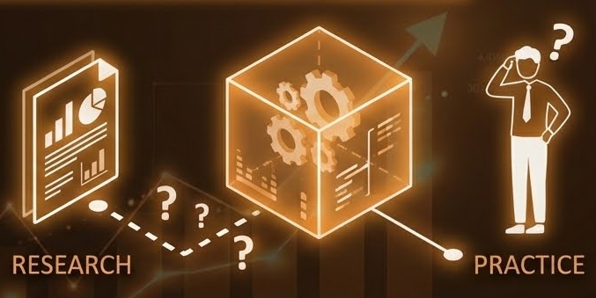
The gap between research and practice
Research explains that leadership is important
It is less clear about what leaders should do next
The “black box” problem: impact is observed, but behaviours are less well specified - Hallinger and Heck (1996)
Reviews of academic research note a lack of specific, learnable leadership actions - Coe, Kime and Singleton (2022)
Notes:
Despite strong evidence that leadership matters, the profession has struggled to specify exactly what leaders should do differently in practice. Hallinger and Heck described this as the black box of leadership, where impact is observed but the behaviours that produce it are less clearly defined. More recent reviews reinforce this point, noting a lack of specific, well defined actions that leaders can deliberately choose, practise, and improve. Broad leadership practices are not the same as actionable behaviours. This gap between research and practice is the core problem the framework addresses.

Slide 7

Why codification matters
Codification names and defines effective behaviours
It turns principles into observable, coachable actions
It makes leadership learnable, repeatable and scalable
Notes:
Codification is the process of naming, defining, and sequencing behaviours so they can be practised, coached, and refined. It does not remove judgment or reduce leadership to a checklist. Instead, it reduces reliance on intuition alone and makes expert judgment more repeatable. By focusing on observable actions, codification improves consistency without enforcing uniformity. Without codification, excellence remains locked inside individuals. With it, improvement becomes more reliable across teams and across time.

Slide 8
From teaching to leadership
Teaching has benefited from codification
Doug Lemov codified what effective teachers already did
Leadership deserves the same clarity
Notes:
As a profession, we are already familiar with codification through teaching. Lemov did not invent great teaching. He captured and codified what effective teachers were already doing, making those practices visible, discussable, and improvable. That clarity helped teachers practise deliberately and improve more quickly. Everyone Succeeds applies the same discipline to leadership, capturing what already works and giving leaders the same level of clarity and precision.

Slide 9
What Everyone Succeeds is
A codified, behaviour-based leadership framework
54 behaviours organised into five leadership domains
Grounded in research and real school practice
Notes:
Everyone Succeeds is a codified, behaviour-based leadership framework grounded in research and close observation of effective school leaders. It focuses on what leaders actually do, not just what they believe or intend. It is not a one-off programme, not dependent on personality or style, and not an additional initiative layered on top. It is designed to support long-term leadership growth by making development practical, actionable, and sustainable.

Slide 10

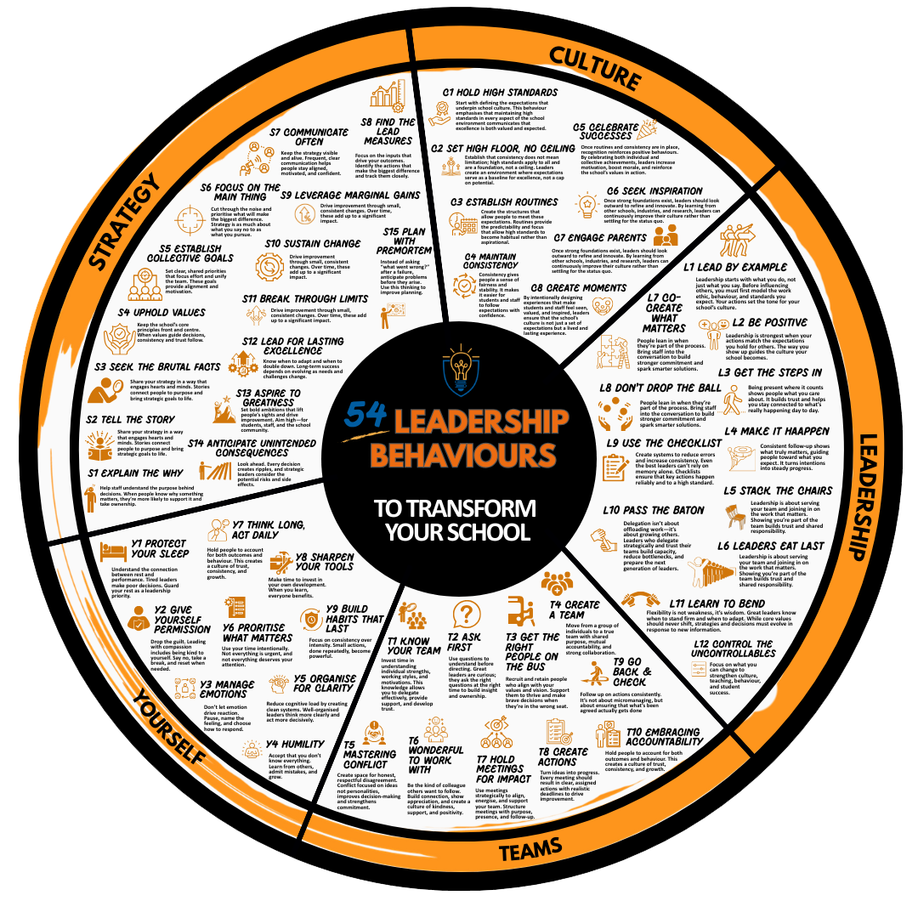
54 leadership behaviours
Notes:
This is an overview of the 54 leadership behaviours in the Everyone Succeeds framework

Slide 11
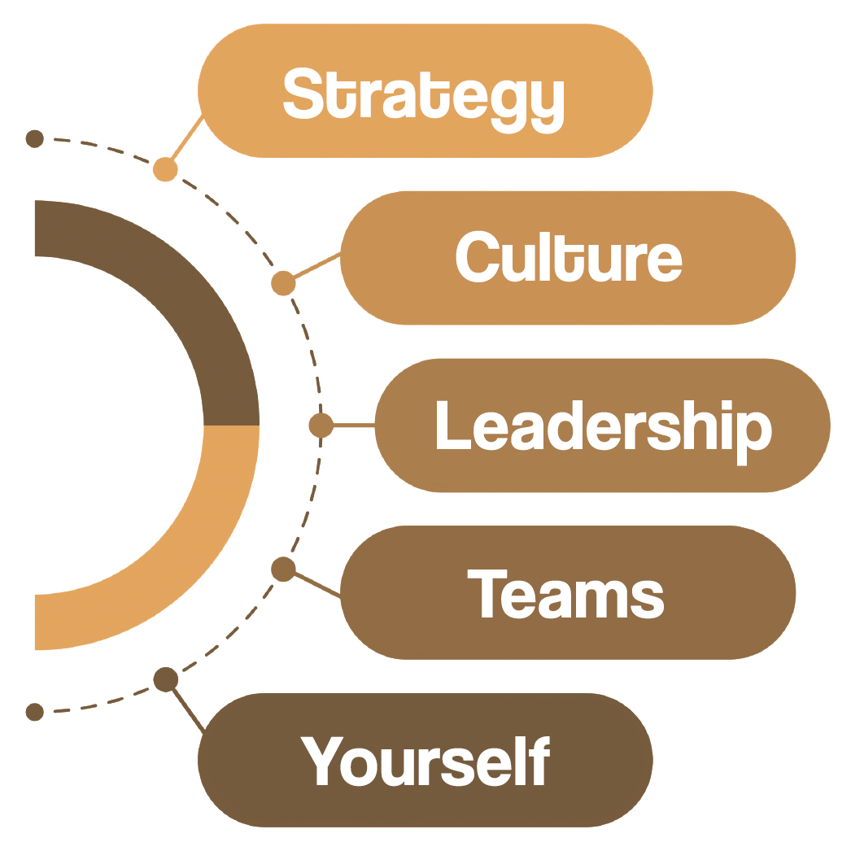
The five leadership domains
Notes:
The behaviours are organised into five domains that reflect the full reality of school leadership. Strategy focuses on direction and priorities. Culture shapes norms and expectations. Leadership concerns influence and decision making. Teams address how work gets done through others. Yourself recognises that sustainable leadership depends on self management and personal habits. Together, these domains provide a balanced and realistic picture of effective leadership.

Slide 12
54 leadership behaviours
Notes:
This is an overview of the 54 leadership behaviours in the Everyone Succeeds framework

Slide 13

Choosing your leadership behaviour focus
THE HYBRID LEADERSHIP MODEL
01
02
03
04
05
Diagnose school priorities
Diagnose individual strengths and needs
Select personal focus behaviours
Review and repeat as priorities evolve
Select shared behaviours
Senior leaders review improvement priorities and identify where strengthening leadership behaviours will have the greatest leverage.
Up to 3 high leverage behaviours are chosen.
Leaders enter the Learn and Lead phases of the Everyone Succeeds Leadership Cycle together.
Leaders complete diagnostics to identify role specific and challenge driven development priorities.
Each leader selects 1 to 3 personal behaviours based on their role, current challenges, and intended impact.
Leaders continue within the Learn and Lead phases of the Everyone Succeeds Leadership Cycle.
All development continues within the Everyone Succeeds Leadership Cycle,.
Notes:
This is the approach to how behaviors are chosen. Identifying whole school priorities will enable behaviors to be chosen at a whole school level. There are opportunities to diagnose your own strengths and developmental needs, which will enable leaders to develop their own personal behaviors to be developed. This is a process that will be repeated as priorities evolve and time passes.

Slide 14
Choosing your leadership behaviour focus
THE HYBRID LEADERSHIP MODEL
01
02
03
04
05
Diagnose school priorities
Diagnose individual strengths and needs
Select personal focus behaviours
Review and repeat as priorities evolve
Select shared behaviours
Senior leaders review improvement priorities and identify where strengthening leadership behaviours will have the greatest leverage.
Up to 3 high leverage behaviours are chosen.
Leaders enter the Learn and Lead phases of the Everyone Succeeds Leadership Cycle together.
Leaders complete diagnostics to identify role specific and challenge driven development priorities.
Each leader selects 1 to 3 personal behaviours based on their role, current challenges, and intended impact.
Leaders continue within the Learn and Lead phases of the Everyone Succeeds Leadership Cycle.
All development continues within the Everyone Succeeds Leadership Cycle,.
Notes:
During this session, we will be working on a shared behaviour where we will be developing our knowledge and implementation of this one behaviour. This will help to create a shared language of leadership within the school.

Slide 15

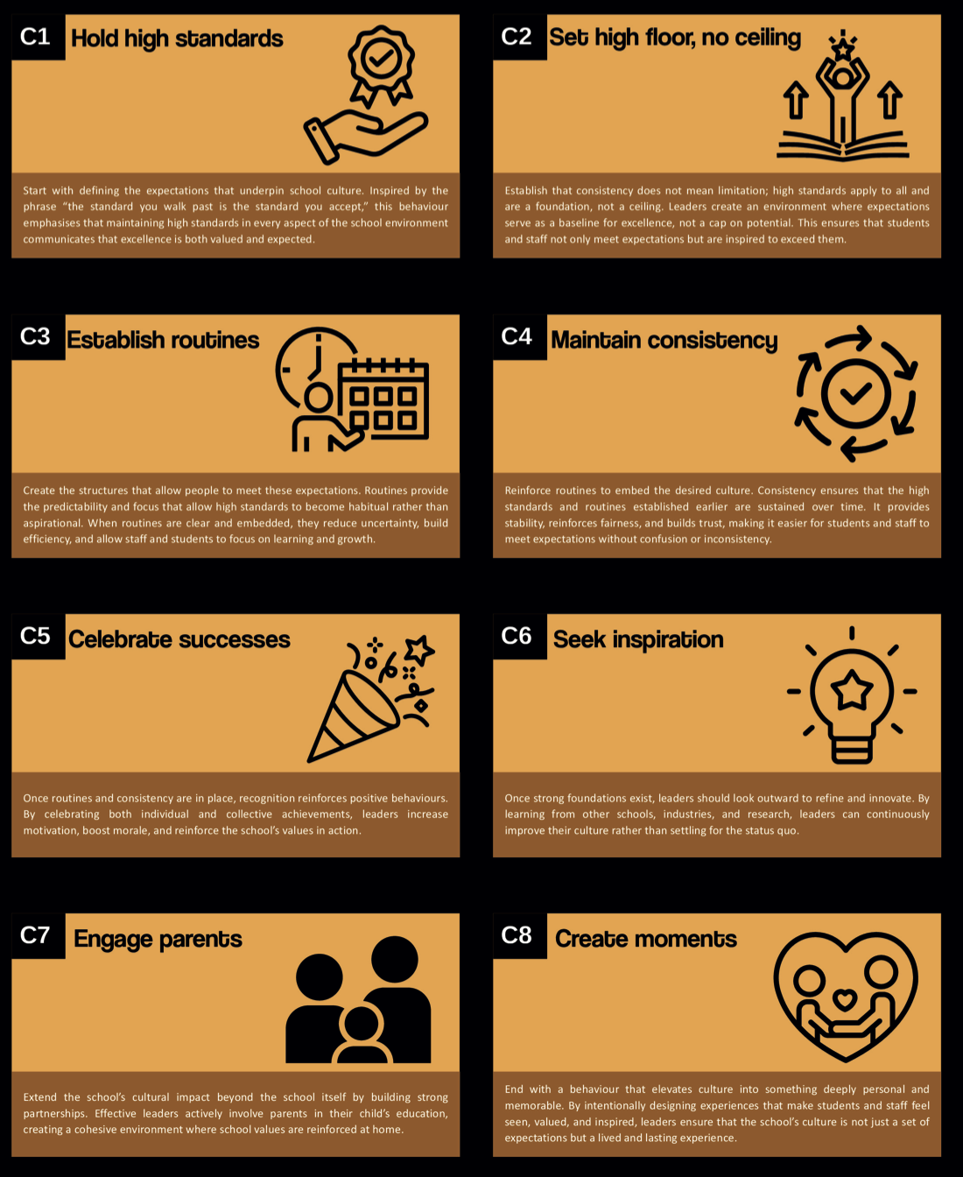
Notes:
There are a number of different behaviors within this domain.

Slide 16
Notes:
We are drilling down on one particular behaviour within this domain

Slide 17

C1. Hold High Standards
High standards shape what students believe is possible for themselves.
Clear expectations create consistency and confidence for staff.
Strong standards protect the culture of the school over time.
Notes:
Standards define the culture of a school. When leaders hold high standards consistently, students experience clarity and fairness. Staff know what excellence looks like and feel supported in maintaining it. When standards weaken, even slightly, culture begins to drift.

Slide 18
When this behaviour is missing
Expectations vary between classrooms or teams.
Leaders tolerate small compromises that gradually lower standards.
Staff feel uncertain about what good practice looks like.
Students quickly learn where expectations are lower.
Notes:
Standards rarely collapse suddenly. They erode gradually through small compromises. Leaders may avoid difficult conversations, delay addressing issues, or assume expectations are understood. Over time this creates inconsistency and confusion.

Slide 19
What holding high standards looks like in practice
Leaders clearly articulate what excellence looks like.
Leaders model the standards they expect from others.
Leaders address issues promptly when expectations are not met.
Leaders reinforce high expectations through everyday conversations.
Notes:
Holding high standards is not about being strict or demanding. It is about clarity and consistency. Leaders communicate expectations openly, support colleagues to meet them, and address issues when necessary.

Slide 20
See it
“We agreed as a staff that students arriving more than five minutes late would be logged on Arbor. Over the past few weeks that has become inconsistent across some classrooms. I want to be clear that this expectation remains in place. Logging late arrivals helps us identify patterns, support students who are struggling to arrive on time, and protect learning time for the rest of the class. From tomorrow, if a student arrives more than five minutes late, it needs to be logged.”
This is not about catching people out. It is not about adding workload. It is a leader reinforcing a standard that has already been agreed.
Notes:
“You’ll work through the full toolkit later. For now, I want you to see what ‘good’ looks like.” The key point here is that leadership is not about catching people out; it is simply holding others to pre-established standards which have been agreed. You owe it to both your students and colleagues to ensure that these are adhered to.

Slide 21

Silent reflection
Where do high standards show up clearly in your leadership?
Where might reinforcing standards make the biggest difference right now?
1 MINUTE
Notes:
Use this moment to pause for silent reflection and consider the questions and how they will affect their own leadership scenario.

Slide 22
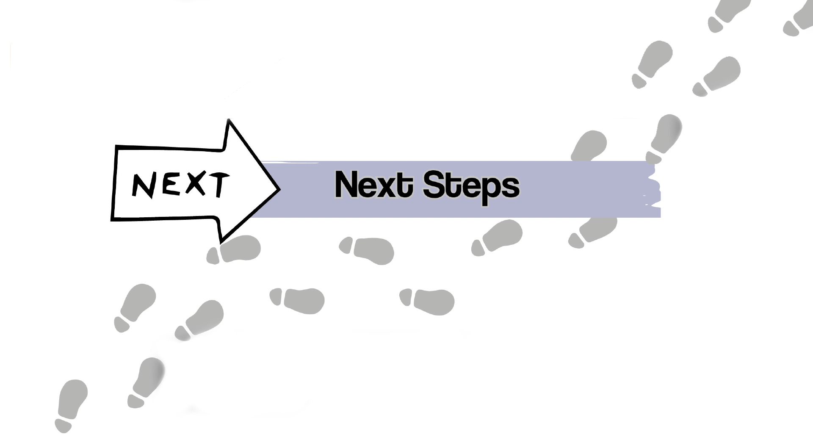


Slide 23
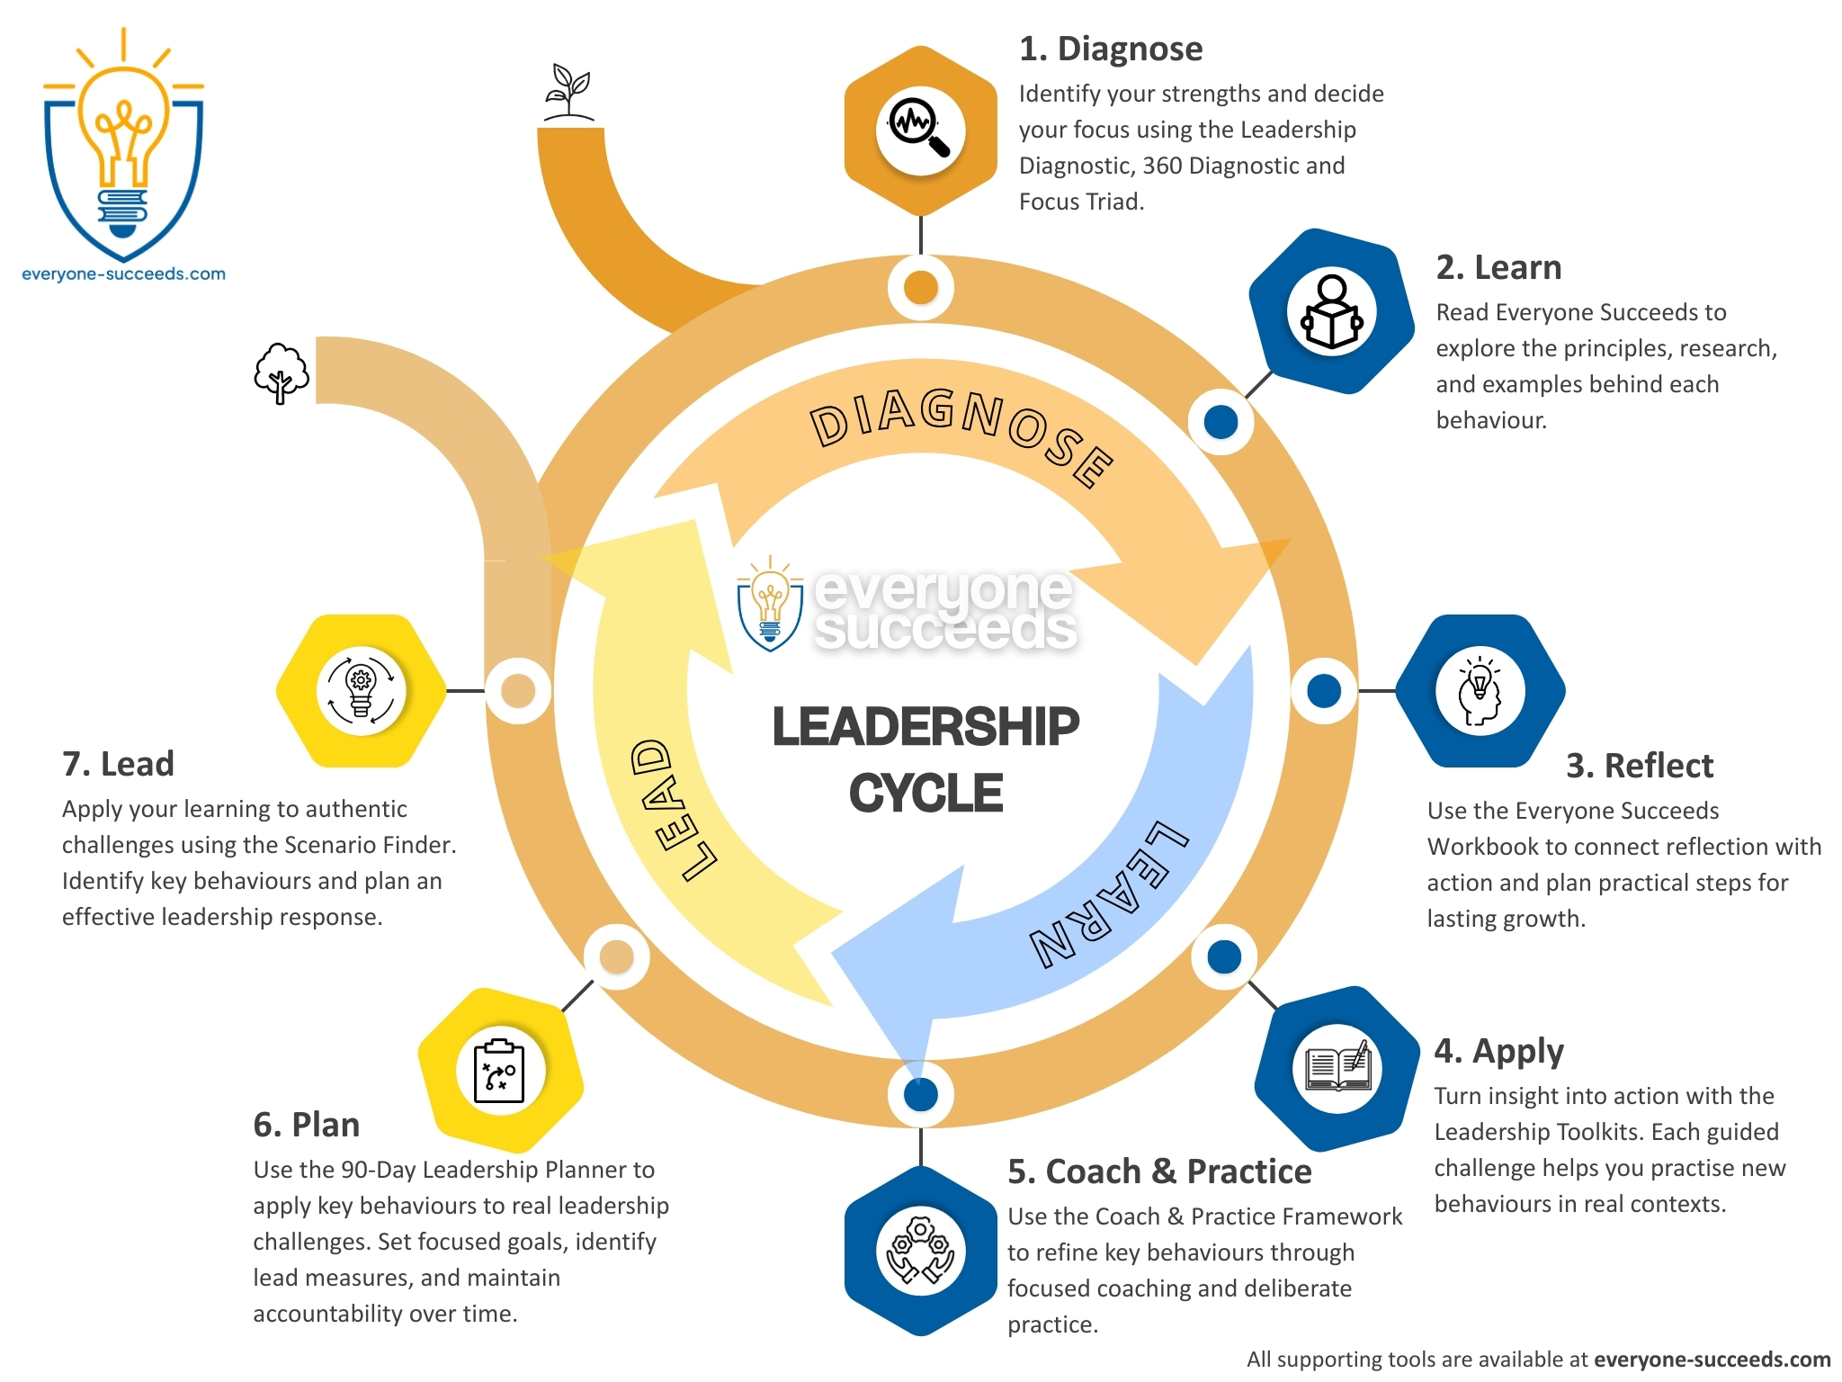
Notes:
The Leadership Cycle explains the seven steps to fully implement a leadership behaviour.

Slide 24
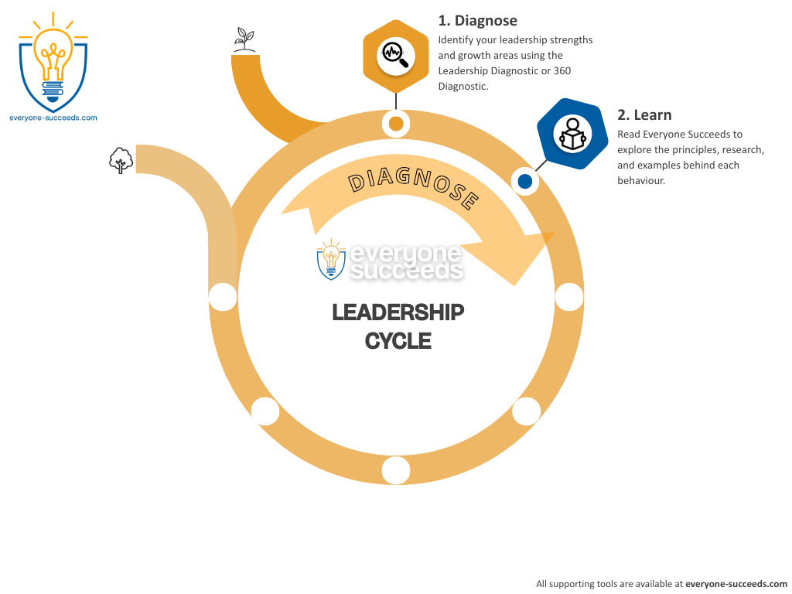

Book
Everyone Succeeds book
Notes:
The learning stage builds deep understanding of effective leadership behaviours through the book, Everyone Succeeds: 54 Leadership Behaviours to Transform Your School. Each behaviour is explored through research, practical examples, and insights drawn from real school and organisational contexts. The book shows what effective leadership looks like in day-to-day practice and helps leaders recognise the habits and decisions that make the greatest difference.

Slide 25

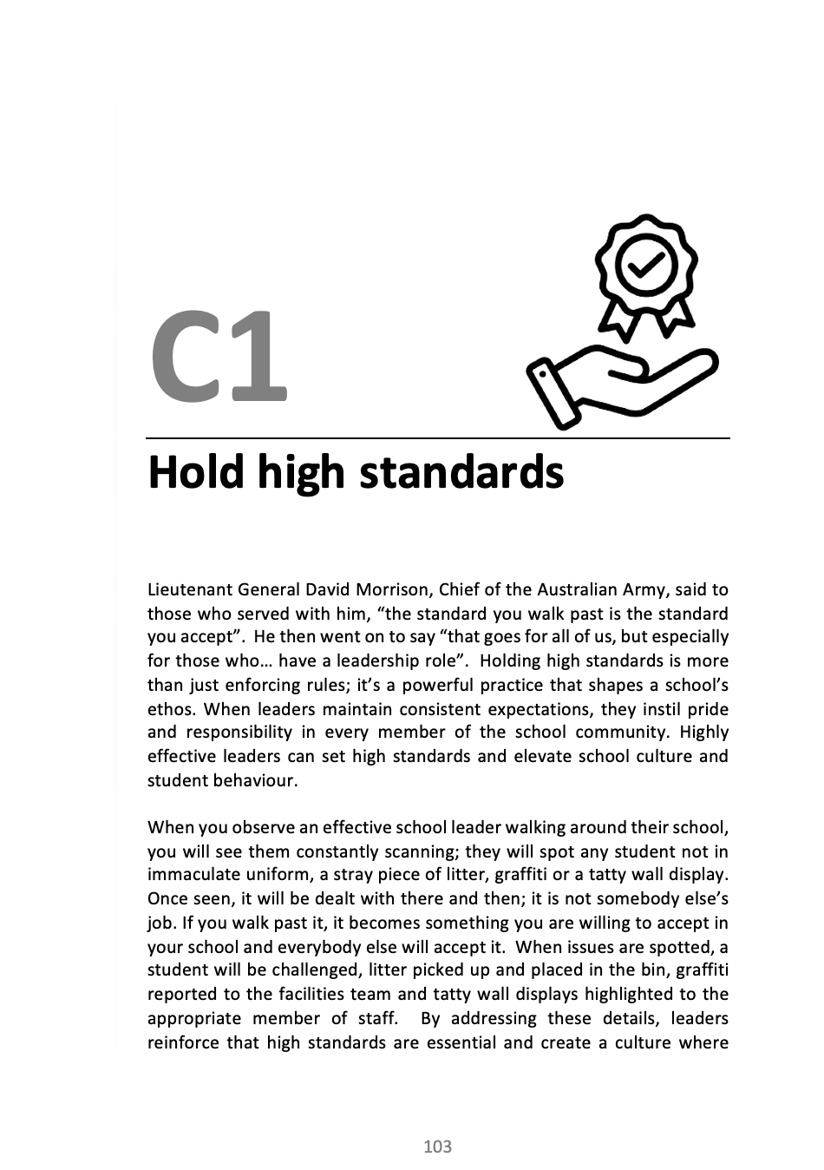
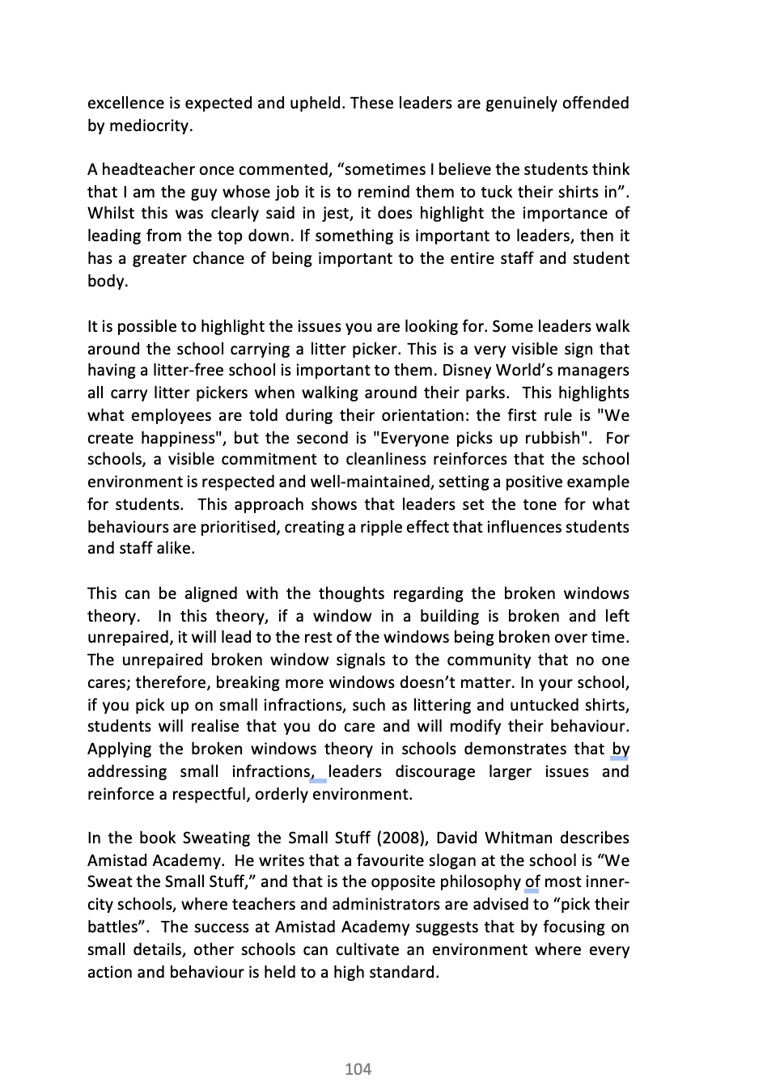
Book: S1. Explain the why
4 MINUTES
Notes:
The learning stage builds deep understanding of effective leadership behaviours through the book, Everyone Succeeds: 54 Leadership Behaviours to Transform Your School. Each behaviour is explored through research, practical examples, and insights drawn from real school and organisational contexts. The book shows what effective leadership looks like in day-to-day practice and helps leaders recognise the habits and decisions that make the greatest difference.

Slide 26

Discussion
Where do high standards show up clearly in your leadership?
Where might reinforcing standards make the biggest difference right now?
2 x
1 MINUTE
Notes:
These discussion questions will now enable you to share the scenario that you are faced with, which can be viewed through the lens of this leadership behaviour.

Slide 27
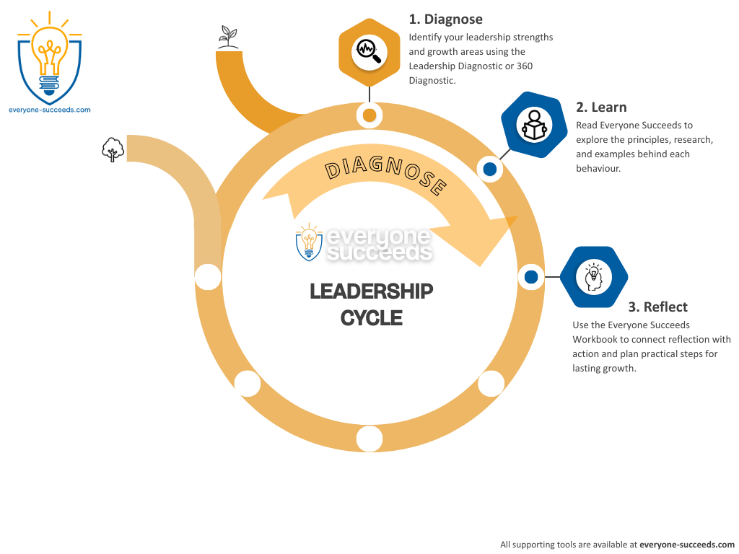

Workbook
Everyone Succeeds workbook
Notes:
Reflection is supported through the Everyone Succeeds Workbook. The workbook provides structured reflection prompts, practical tasks, and planning activities that help leaders make sense of each behaviour in their own setting. It supports deliberate thinking, clarity of focus, and the transition from understanding to purposeful action.

Slide 28

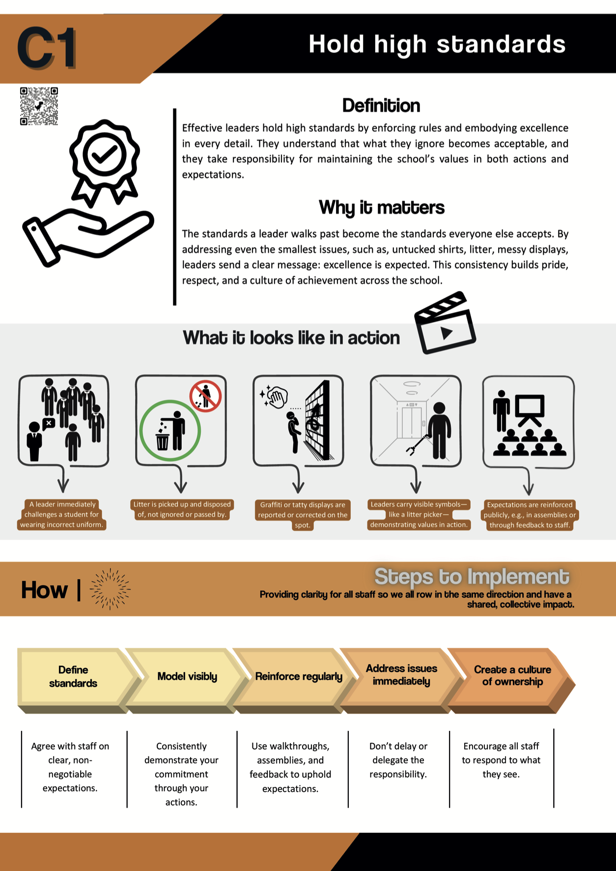
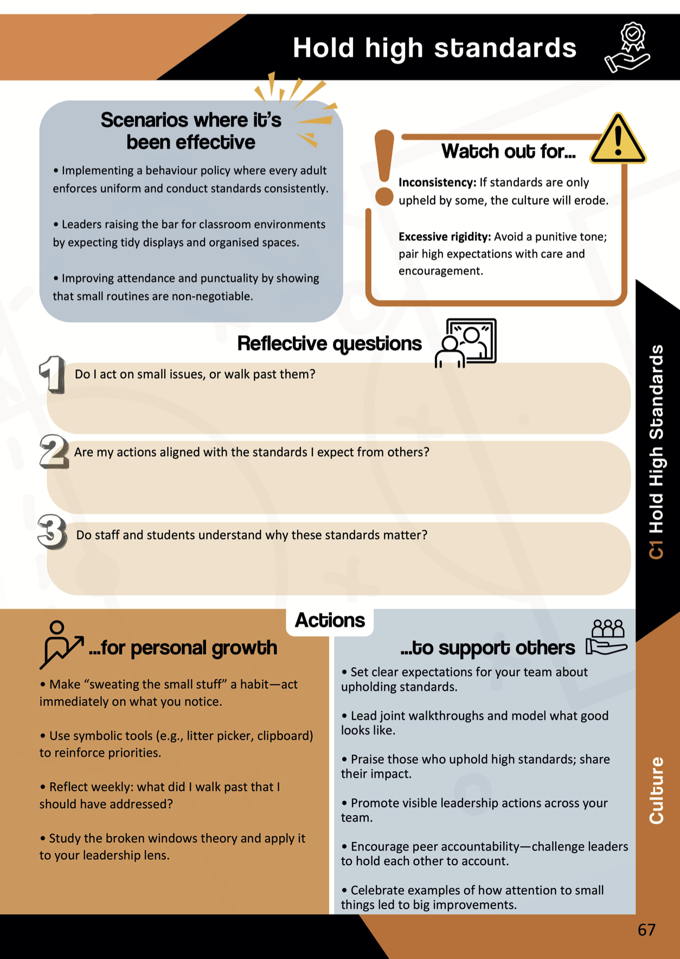
Workbook
4 MINUTES
Notes:
Use the workbook to consider this leadership behaviour and how it is used in action. What are the steps to implementation and different scenarios where it has been effective? It is important for you to watch out for the different situations that may derail the implementation of this leadership behaviour. It is important to consider the three reflective questions. Time can then be taken to consider the actions for personal growth as well as supporting the growth of others.

Slide 29
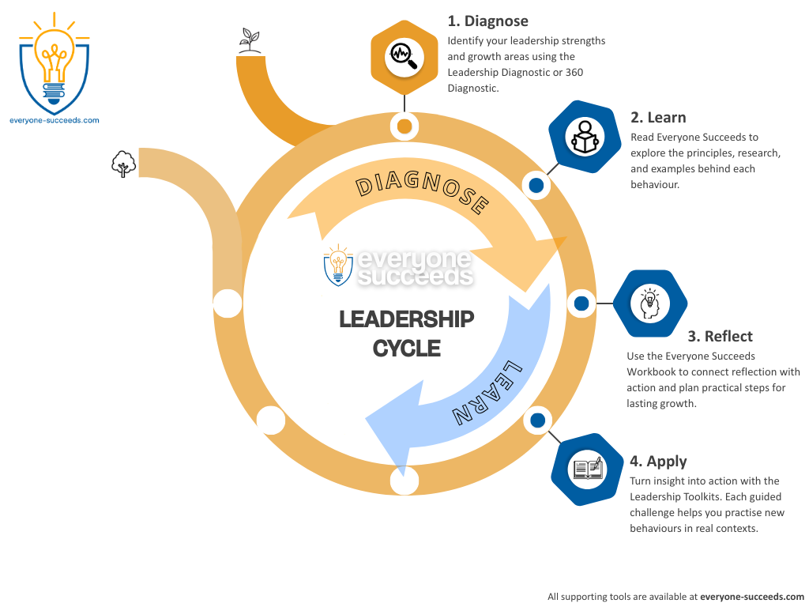
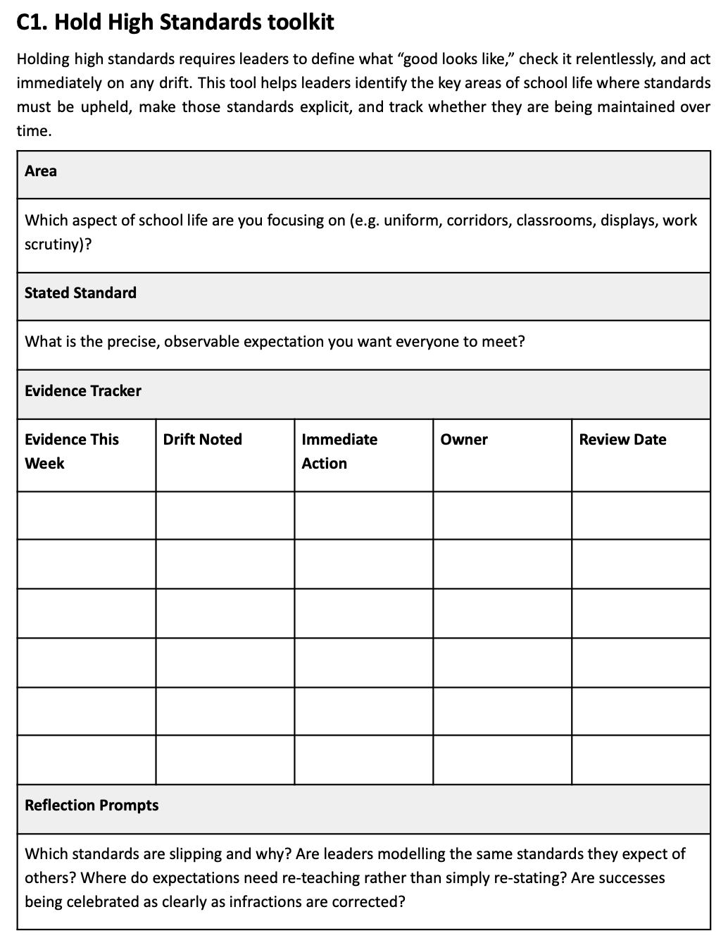
Toolkit
The toolkit presents a realistic challenge, a modelled example, and structured prompts
Notes:
Application is supported through the Leadership Toolkits. Each toolkit focuses on a specific leadership behaviour and presents realistic challenges, modelled examples, and structured prompts. Toolkits help leaders act with confidence in real situations and transfer learning into everyday leadership practice, particularly when facing complex or high-pressure moments.

Slide 30

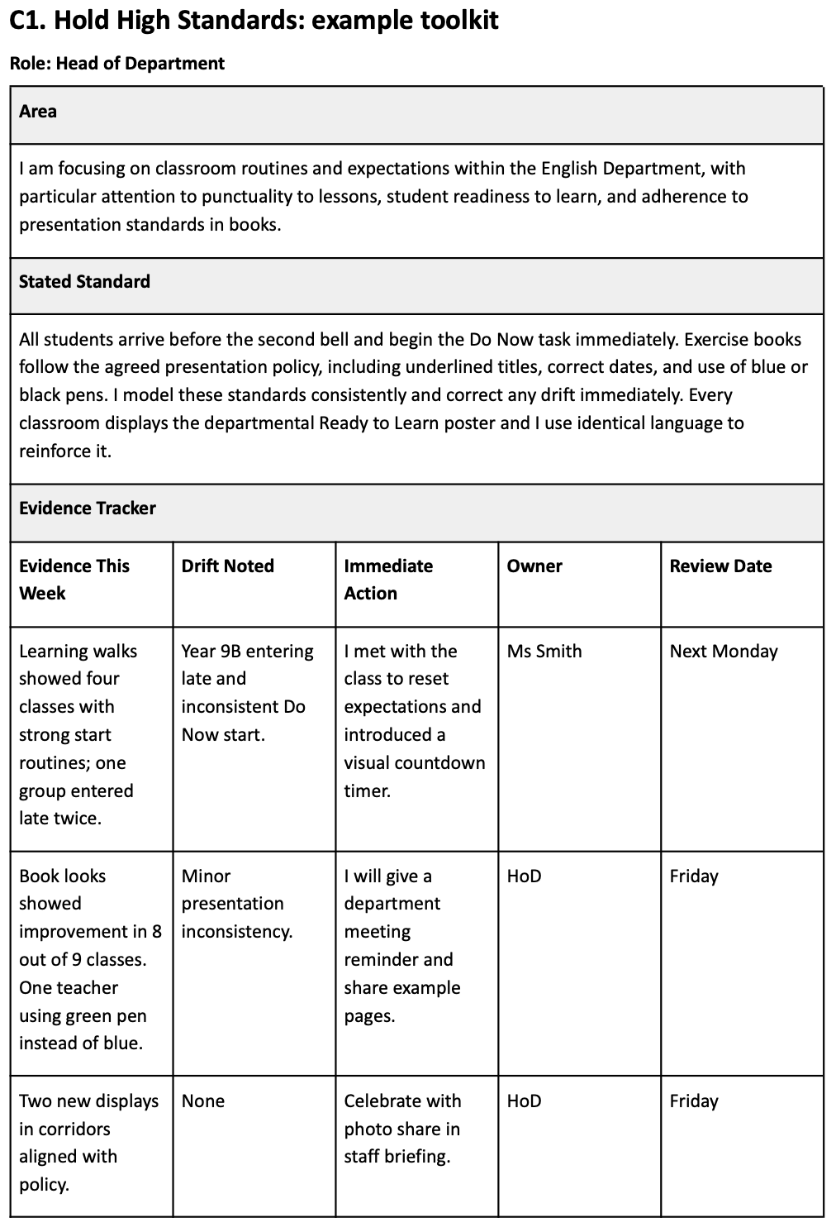
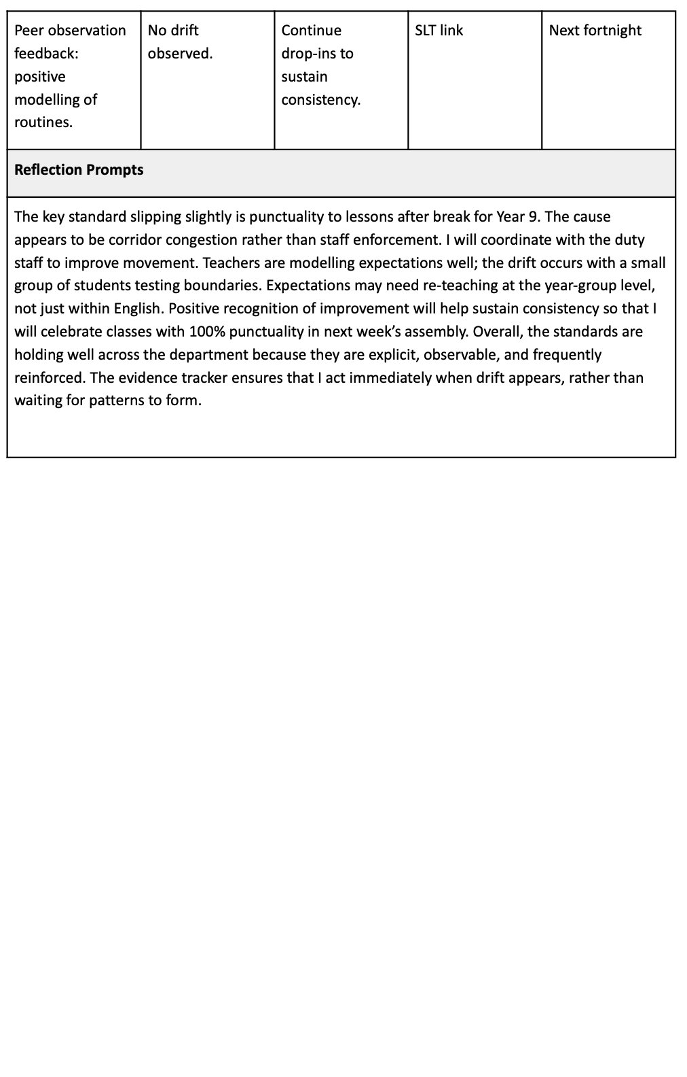
The toolkit
2 MINUTES
Notes:
This is a completed toolkit example which will hopefully give you an insight into how another leader has utilised this toolkit and applied it to their own leadership scenario

Slide 31
The toolkit
What are you focusing on?
10 MINUTES
What are your expectations?
Notes:
You will now have time to work on your own toolkit taken from the Everyone Succeeds website. It is important to consider all of the aspects in the toolkit and how you will apply it to your own leadership scenario.

Slide 32
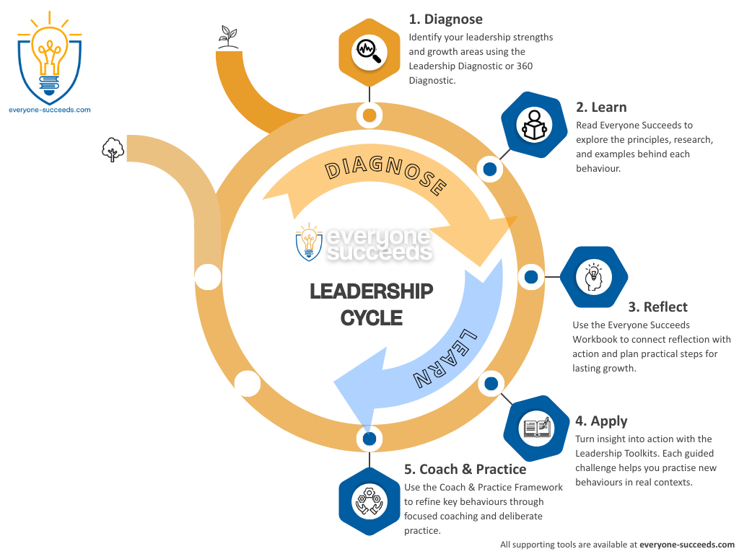
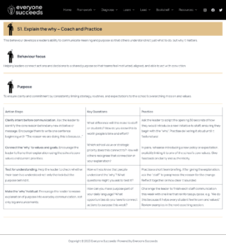
Coach & practise
Clear action steps, reflection questions and deliberate practice opportunities.
Notes:
The coach and practise stage focuses on strengthening behaviours over time. The Coach and Practise Frameworks provide clear action steps, focused reflection questions, and opportunities to deliberately rehearse leadership behaviours. They can be used individually, with a coach, or alongside colleagues to support habit formation and consistency. Today you will be doing it on your own and then having an opportunity to practice with somebody else. You will also get feedback on your practice, which will help improve your rollout script.

Slide 33

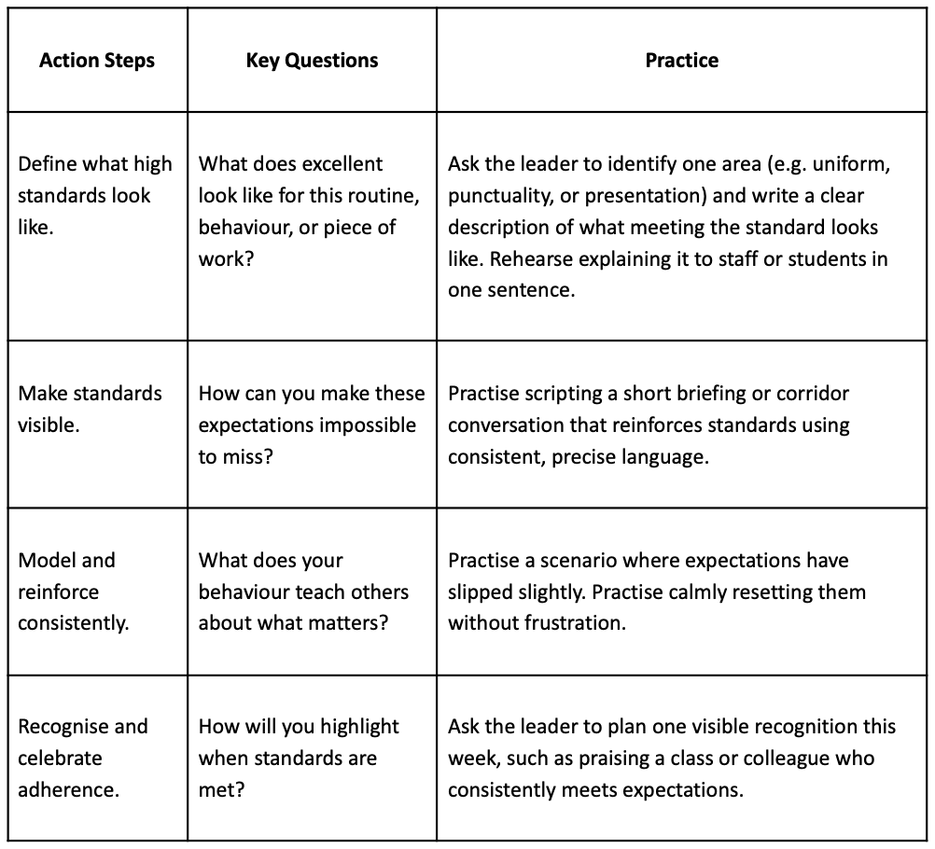
Coach and practise
Notes:
The coach and practise stage focuses on strengthening behaviours over time. The Coach and Practise Frameworks provide clear action steps, focused reflection questions, and opportunities to deliberately rehearse leadership behaviours. They can be used individually, with a coach, or alongside colleagues to support habit formation and consistency. Today you will be doing it on your own and then having an opportunity to practice with somebody else. You will also get feedback on your practice, which will help improve your rollout script.

Slide 34
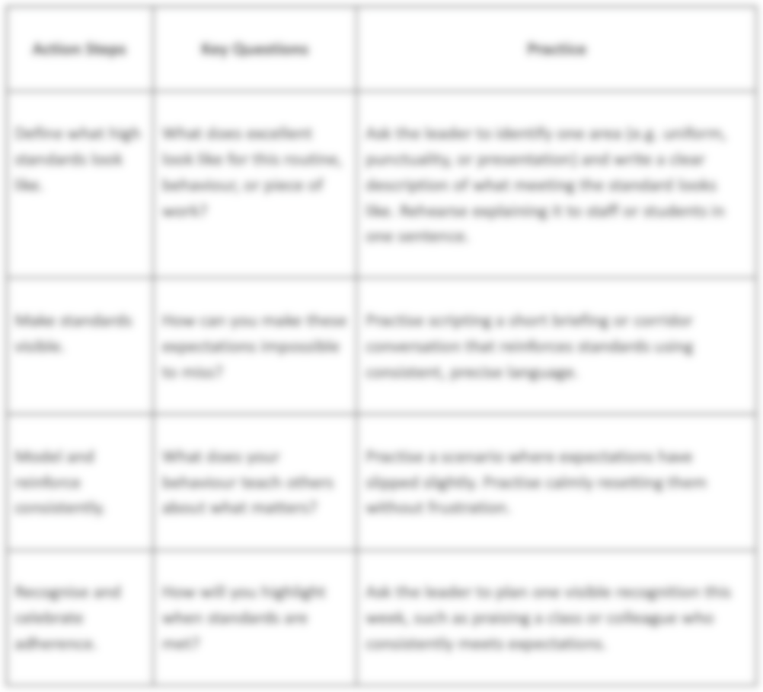
Coach and practise
Notes:
When thinking about how you will implement your toolkit, it is important to consider these key questions when developing your script for the practice.

Slide 35
Coach and practise
Notes:
This is the section of the practice that we will be focusing on today.

Slide 37
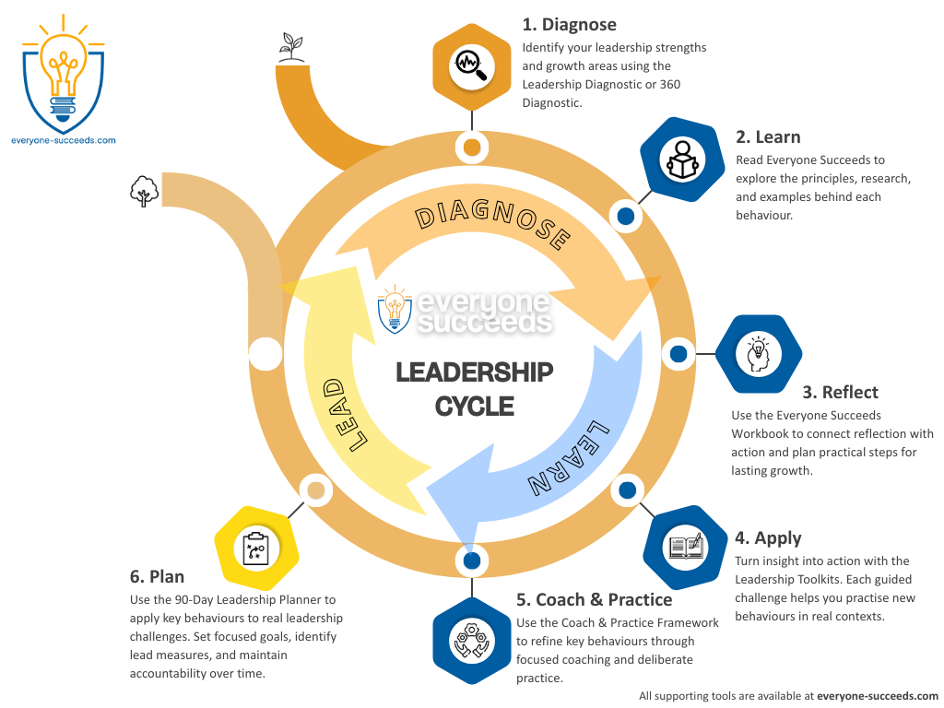
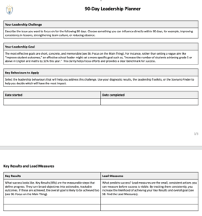
90 day planner
The 90 day planner supports focus, accountability, and reflection.
Notes:
Planning is supported through the 90 Day Leadership Planner. Leaders identify a challenge they can influence, set a clear goal, and define the Lead Measures and Key Results that will drive improvement. The planner supports focus, accountability, and reflection through 30, 60, and 90 day checkpoints, helping leaders move from intention to impact.

Slide 38
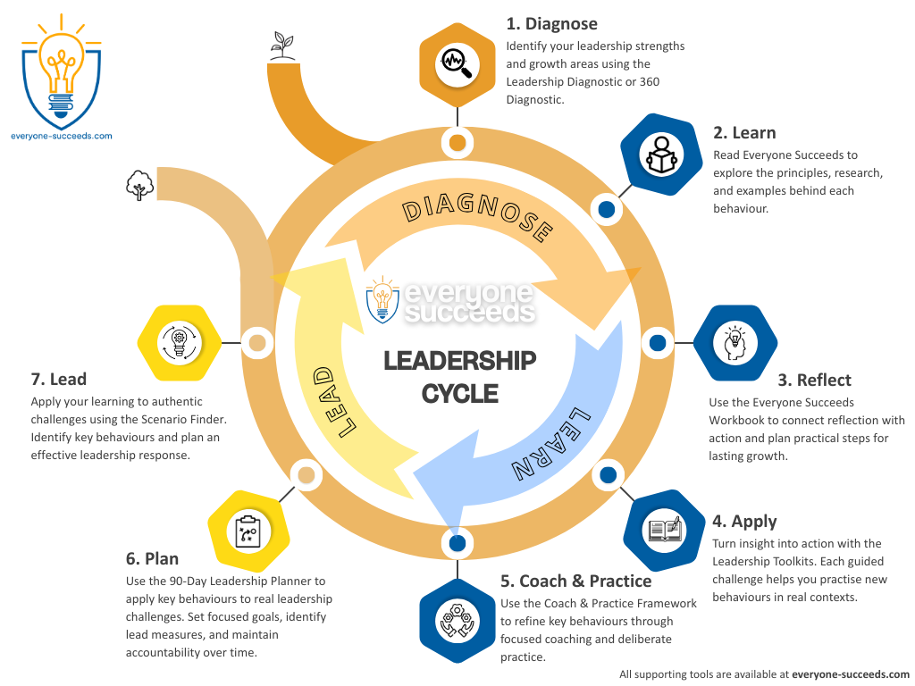
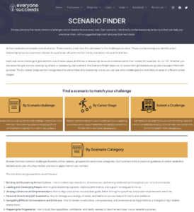
Scenarios
Over 50 realistic leadership scenarios, each mapped to relevant behaviours.
Notes:
The final stage focuses on applying learning to real leadership situations through the Scenario Finder. This resource includes over 50 realistic leadership scenarios, each mapped to relevant behaviours. Leaders use these scenarios to practise decision-making, prepare for challenging moments, and build confidence in responding consistently across their school or trust.

